Slide 1
Impact of Thread Virtualization on Docker compared to the Native system
By Harsh Nagarkar

Slide 2
Introduction to Question
How does the performance of multithreaded programs get affected by use of a Docker container Vs a native system?
Evaluation with respect to time.

Slide 3
What is Virtualization?
Method or a program that allows complete segregated running of software.
Independent set of: Memory, CPU power, Network,etc.
Notes:
Seperate memory, cpu power, network, eg:- program like backend server, database,etc

Slide 4
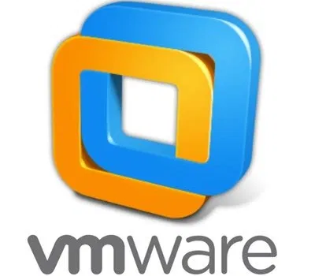

Types of Virtualization- HyperVisor
Type 2 - hosted hypervisor Type 1 - bare metal hypervisor https://magazine.odroid.com/article/kvm-fun-with-virtualization-on-the-odroid-h2/ https://www.betterhostreview.com/move-virtual-machines-another-drive-windows-pc.html

Slide 5

Types of Virtualization- Containers What is Docker?
https://www.docker.com
Notes:
Operating system virtualization

Slide 6
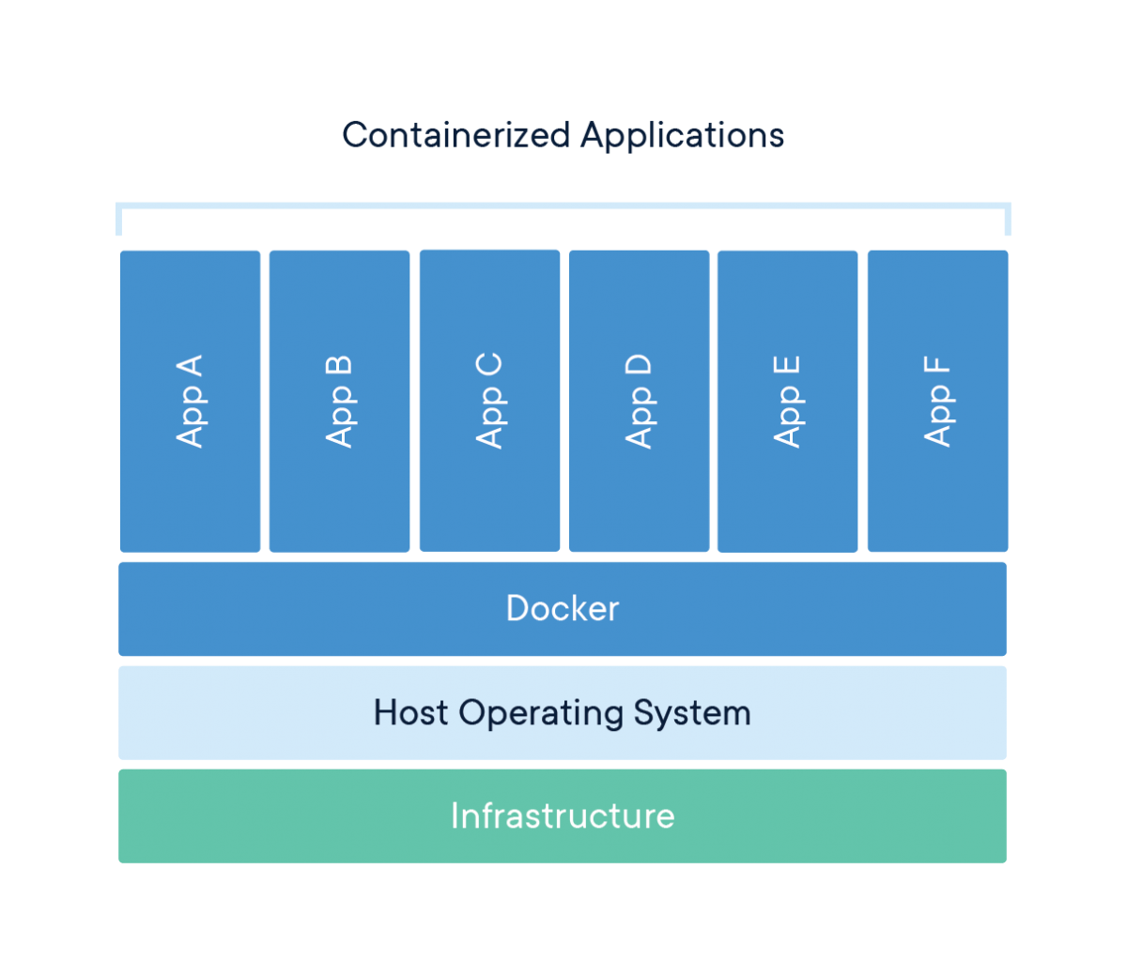
Architecture of Docker
https://www.docker.com

Slide 7
Methods & Workings

Slide 8
Infrastructure
Google Cloud Platform
8 CPU Cores | 8 GB Ram

Slide 9
Languages
Python | Go | C
Threaded Programs
Matrix Multiplication | Pi Value Calculation | DNS resolver
Error 0.01 | Error 0.02 | Error 0.08

Slide 10
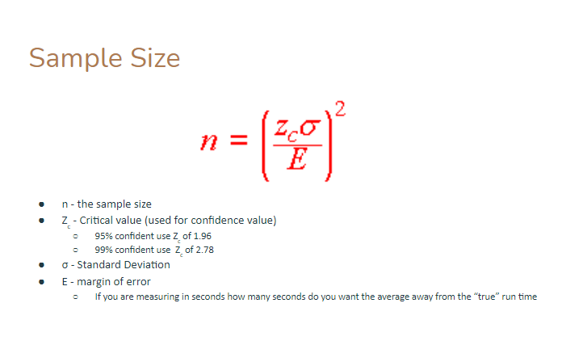
Sampling
Big sample set. Calculated using
https://drive.google.com/drive/u/1/folders/1nu6vhfa8O3H9MmNH_ARujeZdM2Xn3BtA @Bryan Dixon Performance Measurement

Slide 11
Results

Slide 12
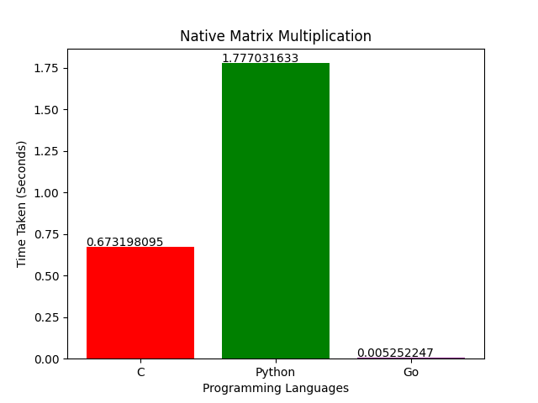
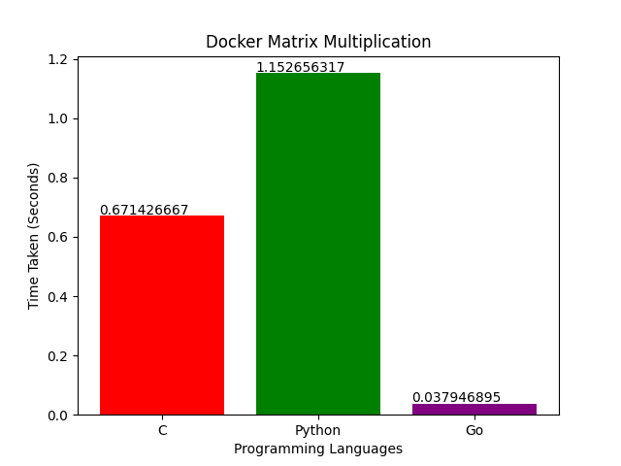
Matrix Multiplication (100x100)*Thread

Slide 13
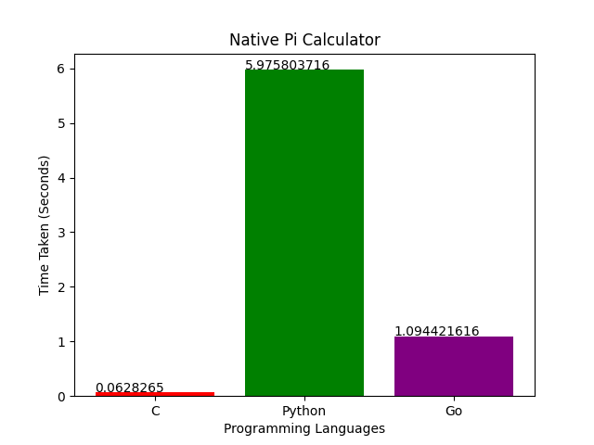
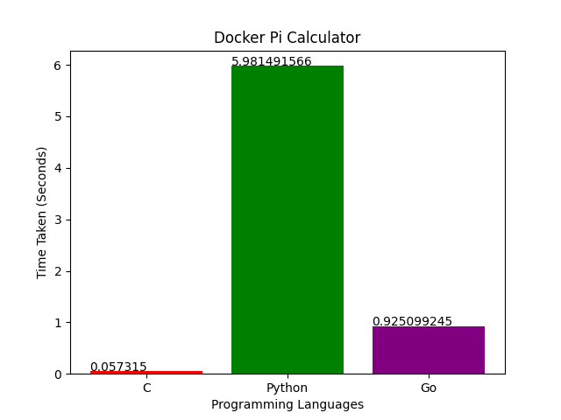
Monte Carlo Pi Calculator (3mil points)30 Threads

Slide 14
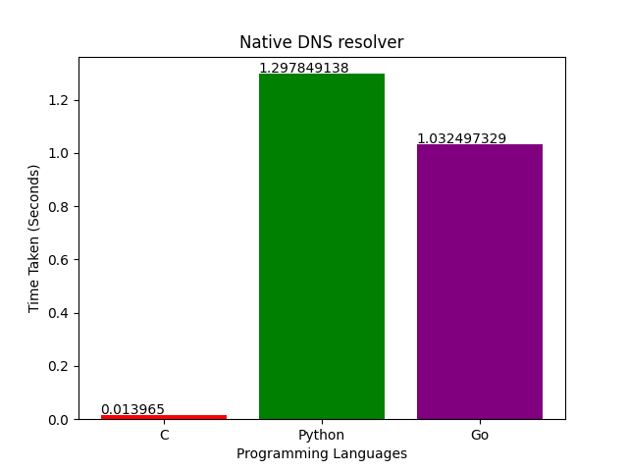
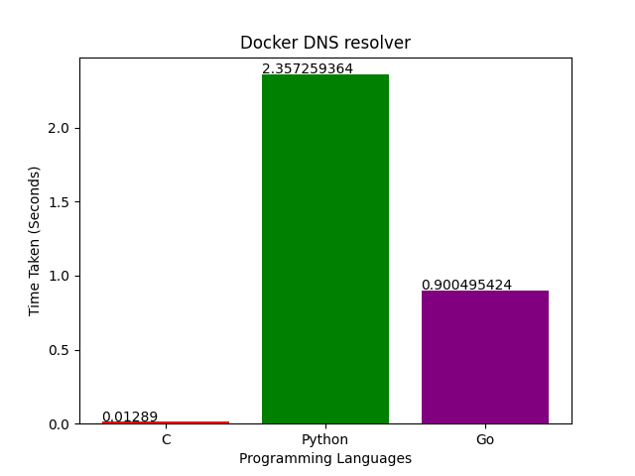
DNS resolver (122 Domain names )
Notes:
Print statement

Slide 15
Sources of Error
Language difference :- array, waithgroup and list , Go channels and Queues
DNS resolver 1,2 extra mutexes in C
Network Performance

Slide 16
Conclusion
Compute heavy-> Native, Go
Synchronization -> C either is fine
I/O Bound -> C either is fine

Slide 17
Conclusion
Docker add noticeable Overhead in Networking, Compute performance but also provides necessary separation.
Native system could be faster in computer heavy tasks

Slide 18
References
Matrix: https://macboypro.wordpress.com/2009/05/20/matrix-multiplication-in-c-using-pthreads-on-linux/
Pi: https://github.com/michaelballantyne/montecarlo-pi/blob/master/pi.c
DNS: https://github.com/jjjacobsen/multi-threaded-DNS-lookup

Slide 19
Thank You

